Slide 1


Social Buzz

Slide 2


Today's agenda
Project recap
Problem
The Analytics team
Process
Insights
Summary

Slide 3

Over the past 5 years, Social Buzz has reached over 500 million active users each month. They have scaled quicker than anticipated and need the help of an advisory firm to oversee their scaling process effectively.
Every day over 100,000 pieces of content, ranging from text, images, videos and GIFs are posted. All of this data is highly unstructured and requires extremely sophisticated and expensive technology to manage and maintain.
Project Recap

Slide 4

Problem
Every day over 100,000 pieces of content
Social Buzz has reached over 500 million active users each month

Slide 5



MICHELLE
CHIEF TECHNICAL ARCHITECT
The Analytics team
MARCUS
SENIOR PRINCIPLE
{Myself}
DATA ANALYST

Slide 6
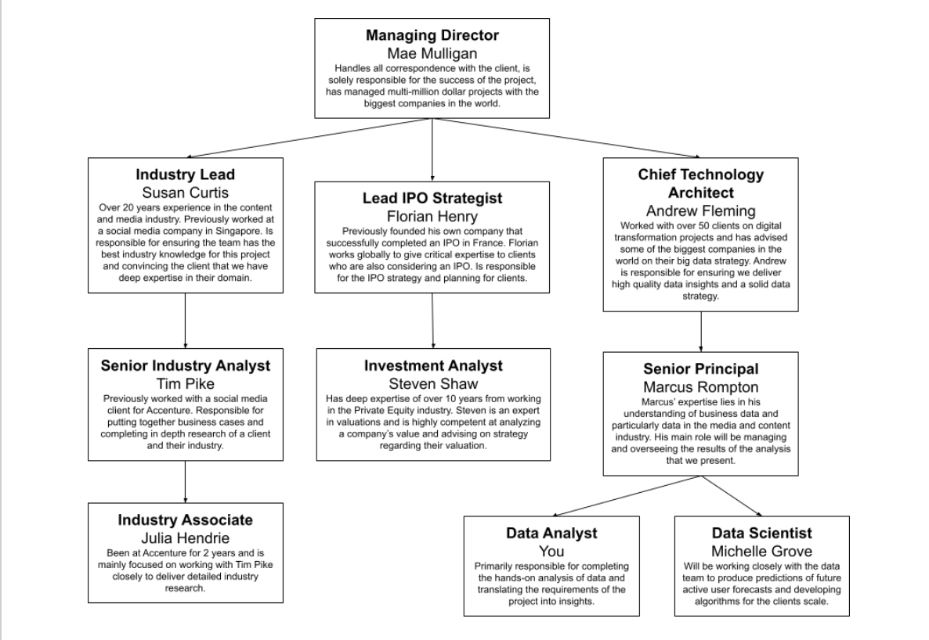

Slide 7
Process
1
DATA UNDERSTANDING
2
DATA CLEANING
DATA MODELLING
3
4
DATA ANALYSIS
5
UNCOVER INSIGHTS

Slide 8


Insights

Slide 9
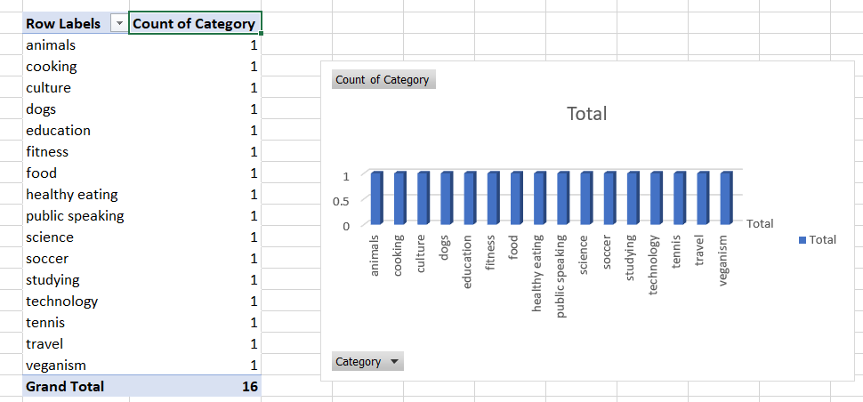

Slide 10
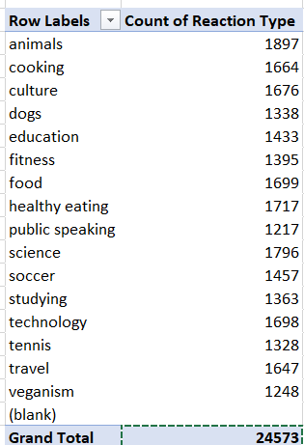

Slide 12

There are 16 Unique items present in the dataset .
Summary
Highest reaction types are animals , healthy eating, cooking, culture
The most posted month is May followed by January and August.

Slide 13
Thank you!
ANY QUESTIONS?

